Slide 1
SJDL-Vehicle: Semi-supervised Joint
Defogging Learning for
Foggy Vehicle Re-identification
Group Member: Kyle Collins, Tianfie Xu, Michael Tate, Ping Zhang
Presentation Slides Author: Ping Zhang
Date: 04/16/2023

Slide 2
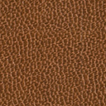
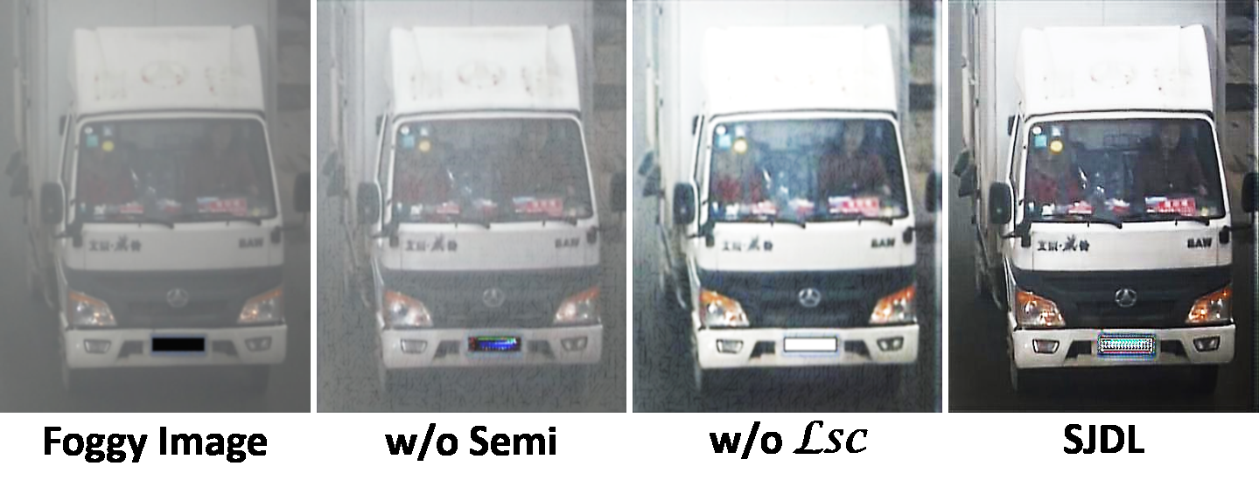
Motivation for the work
Address the problem of vehicle re-identification (ReID) in foggy weather condition
important for building intelligent transportation and public security systems.
Foggy weather conditions can significantly degrade the visibility of images, and existing defogging methods are not specifically designed for ReID
making it difficult for existing ReID methods to accurately identify vehicles.
not always guarantee improved ReID performance.
Heavy computational burden of
most defogging methods
Integrating defogging and ReID models can also
increase the complexity of the system due to
the heavy computational burden of most
Figure1：Defogged results based on different optimization schemes.
Notes:
Though several methods have shown superior performance on the normal images, they usually fail to perform vehicle ReID tasks under the foggy scenario, which is one of the most common weather types that appeared in the real world. This is because these methods are designed for clear images. Fog is an atmospheric phenomenon that consists of smoke, dust, and other floating particles, which may lead to poor visibility and degrade the features extracted from these images for the purpose of vehicle ReID.
The motivation for the work in the paper is to address the problem of vehicle re-identification (ReID) in foggy weather conditions, which is important for building intelligent transportation and public security systems. The technical problem is that existing ReID methods and two-stage defogging methods are not effective in improving ReID performance in foggy conditions. The research question addressed in the paper is how to design a joint defogging learning (JDL) paradigm to improve ReID performance in foggy conditions by simultaneously optimizing defogging and ReID features.
This problem does not have a trivial solution because foggy weather conditions can significantly degrade the visibility of images, making it difficult for existing ReID methods to accurately identify vehicles. Additionally, existing defogging methods are not specifically designed for ReID and may not always guarantee improved ReID performance.
At last, the heavy computational burden of most defogging methods can increase the complexity of the system. Integrating defogging and ReID models can also increase the complexity of the system due to the heavy computational burden of most defogging methods.

Slide 3
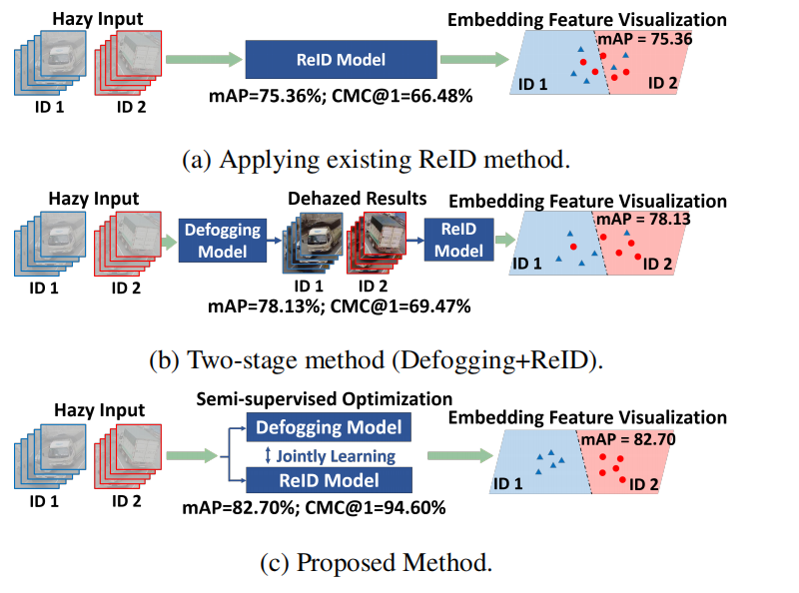
Proposed solution
Semi-supervised joint defogging learning (SJDL) system
.
Represent an improvement: conduct defogging and vehicle re-identification (ReID) simultaneously to alleviate the vehicle ReID problem in foggy weather.
consists of two branches: the re-identification branch and the defogging branch
share a feature extraction module called the collective feature sharing module (CFSM) to
ensure that the fog-free features generated by this module can be used for ReID to cope with the poor visibility problem.
Figure 2: Comparison of different strategies for vehicle ReID in the foggy weather in terms of the mean average pre_x0002_cision (mAP) and CMC@1.
Notes:
Therefore, a novel joint defogging learning (JDL) paradigm is proposed in this paper to simultaneously optimize defogging and ReID features and improve ReID performance in foggy conditions.
The proposed JDL mechanism is embedded in a two-branch network, which consists of a defogging model, a re-identification model, and a feature sharing module.With the simultaneous optimization paradigm, clean features extracted by the defogging branch from foggy input images for visibility enhancement can be shared to learn better ReID features in the re-identifification branch. Therefore, the performance of ReID in the foggy weather can be improved effectively by this design.

Slide 4
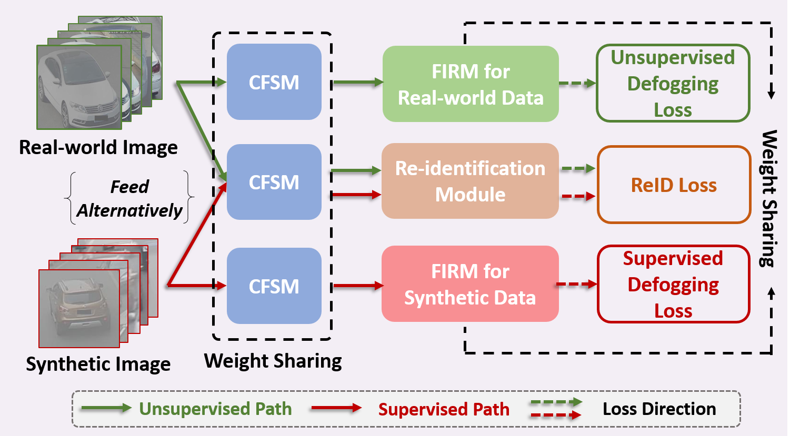
Proposed solution
Represent an improvement: the proposed system is trained on both synthetic and real-world data alternatively to address the domain gap problem.
Unsupervised and supervised defogging optimizations, which are based on different sources of input data, are applied for the defogging branch.
Figure 3: Different sources of data are fed alternatively at the training stage
Notes:
Moreover, since the fog-free ground truth in the real world scenario is intractable, directly leveraging real-world foggy data on the aforementioned training framework is challenging.To well address the domain gap between real-world and synthetic foggy data,the artical proposed a semi-supervised defogging scheme to train our network in a supervised way and an unsupervised way alternatively.
With this mechanism, the domain gap problem can be solved effectively and the proposed method can achieve state-of-the-art performance in both synthetic and real-world datasets.

Slide 5
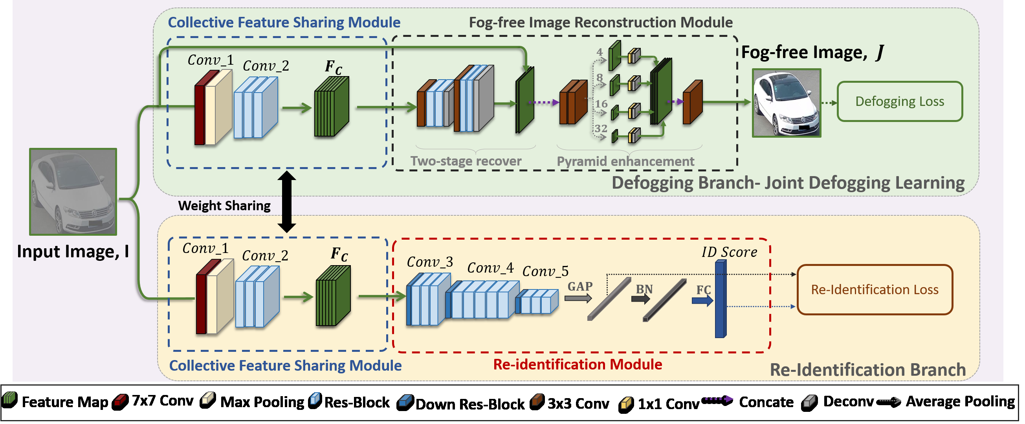
Proposed solution
Represent an improvement: By this architecture, the performance can be improved significantly without additional computational burden at the inference stage.
Training stage, both branches share a feature extraction module CFSM).
Inference stage, only the CFSM and the ReIDM are required to perform ReID.
Figure 3: The architecture of the proposed joint defogging learning network for vehicle ReID
Notes:
As shown in Fig. 4, the proposed architecture mainly consists of two branches: the re-identifification branch (ReIDBranch) and the defogging branch. sTwo branches share the Collective Feature SharingModule to learn defogging and ReID simultaneously. Note that, the defogging branch is only involved in the network during the training stage.
At the training stage, both ReID and defogging branches share a feature extraction module called the collective feature sharing module (CFSM) to ensure that the fog-free features generated by this module termed FC can be applied to each branch in our joint defogging learning architecture. Then, the extracted features FC are passed to the fog-free image reconstruction module (FIRM) and the re-identification module (ReIDM) to produce the corresponding outputs.
At the inference stage, only the CFSM and the ReIDM are required to perform ReID. The computational burden caused by it can be ignored. We calculate the Euclidean distance D through embedding features to evaluate the performance.
By this architecture, the performance of ReID in the foggy weather can be improved significantly without additional computational burden at the inference stage.

Slide 6
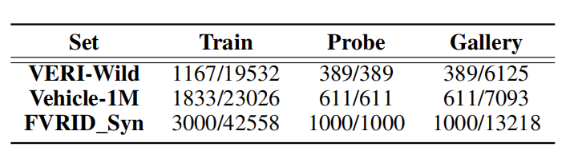
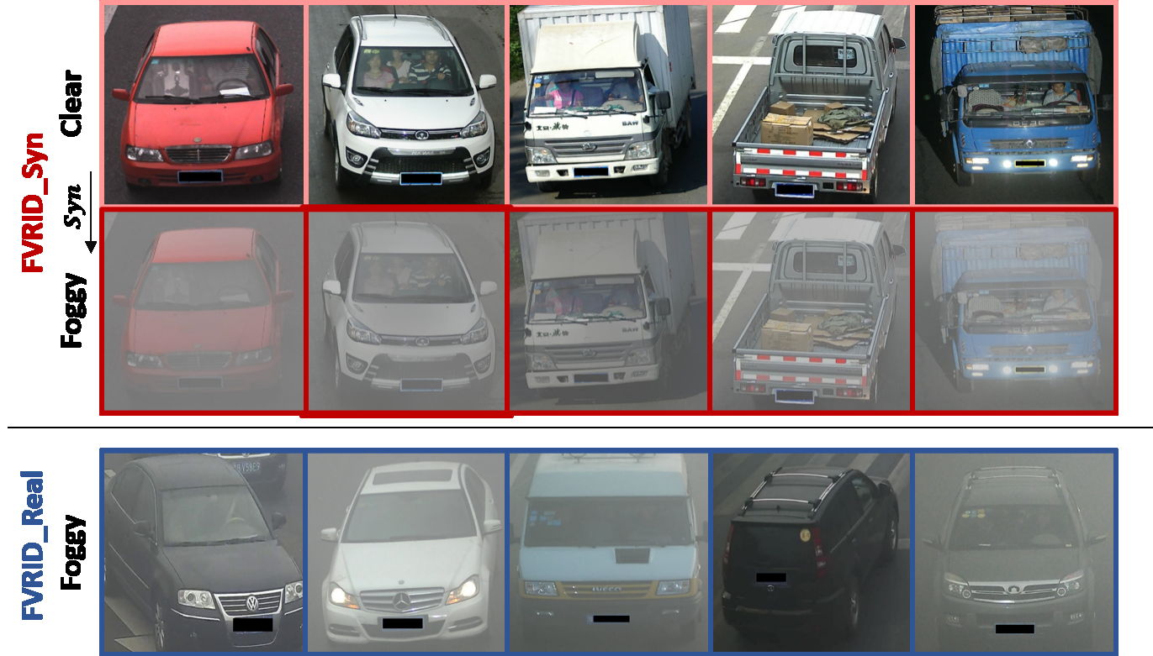
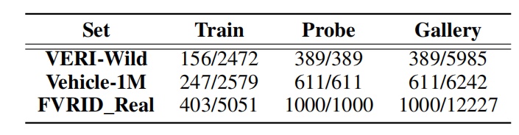
Experiments - construct the dataset
Table 2: The detailed constitution of the FVRID_Syn dataset. (IDs/Images)
Table 1: The detailed constitution of the FVRID_Real
dataset. (IDs/Images)
Figure 4: Examples of the images in FVRID_Real andFVRID_Syn datasets
Notes:
For the real-world dataset, called it the Foggy Vehicle ReID for real-world scenes (FVRID_Real) in this experiments, is constituted based on these two datasets VERIWild and Vehicle-1M datasets , which contain the cases in the foggy weather. The details of this dataset are presented in Table 1.
For the Synthetic Dataset, due to the limited number of vehicle ReID data in foggy weather, to train the proposed network . in this experiment, the auther selected fog-free images from VERI-Wild and Vehicle-1M datasets. Then, we synthesize these images based on the fog synthesis process in.
The experiments are performed on the FVRID_Syn and FVRID_Real datasets. Specififically, the auther randomly select one foggy image for each vehicle and put it into the probe set. The remained images form the gallery set. Then, apply the cumulative matching characteristic (CMC) curve and mean average precision (mAP) to evaluate the performance.

Slide 7
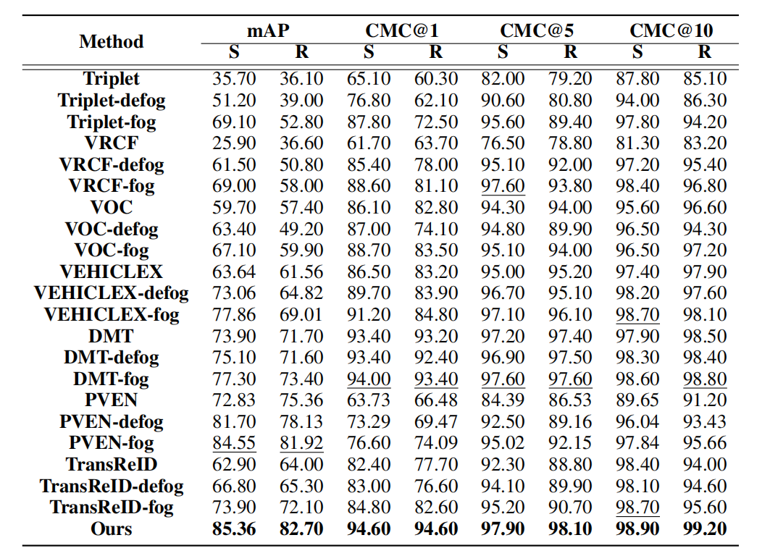
Evaluation - Comparison with the Existing Methods
Anootation:
S: FVRID_Syn dataset;
R: FVRID_Real dataset
Table 1: Quantitative evaluation on the foggy ReID datasets.
Notes:
This artical compare the auther’s method with other existing ReID methods.
fiustly, retrained these models in the foggy scenarios using the same training sets as the proposed one and the obtained ReID models are denoted by previous exsiting artical.
The results are reported in Table3 which show that the proposed method can achieve the best performance on vehicle ReID in foggy weather on FVRID_Syn and FVRID_Real datasets in terms of mAP and CMC.

Slide 8
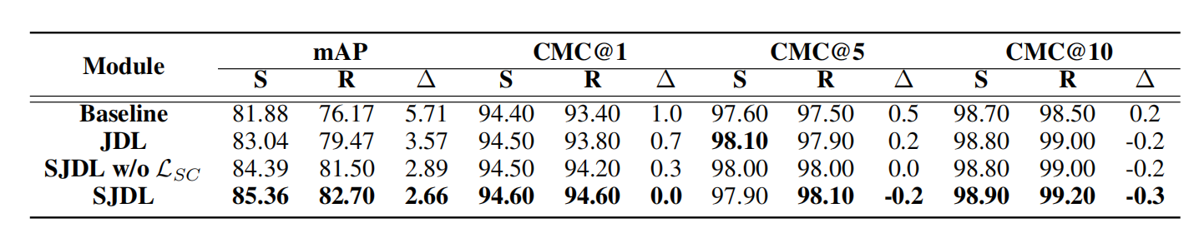
Evaluation - Effectiveness of joint defogging learning and
semi-supervised defogging optimization.
Baseline： presents the ResNet-50.
JDL：denotes the joint defogging learning only with supervised defogging optimization.
SJDL：presents the JDL mech_x0002_anism with the semi-supervised defogging optimization.
Table 4: Effectiveness of the proposed joint defogging learning and semi-supervised defogging optimization.
Annotation: The symbol ’∆’presents the difference between the results of synthetic data and real-world data (The smaller value indicates better performance for addressing the domain gap problem).
Notes:
Effectiveness of the proposed joint defogging learning and semi-supervised defogging optimization. The text ’JDL’denotes the joint defogging learning only with supervised defogging optimization, while the text ’SJDL’ presents the JDL mech_x0002_anism with the semi-supervised defogging optimization, respectively. The ’Baseline’ presents the ResNet-50.
Moreover, with semi-supervised learning, the domain gap between real world and synthetic scenarios is reduced effectively.
The results are reported in Table4 which show that the proposed joint defogging learning and semi-supervised defogging optimization method can achieve the best performance.

Slide 9
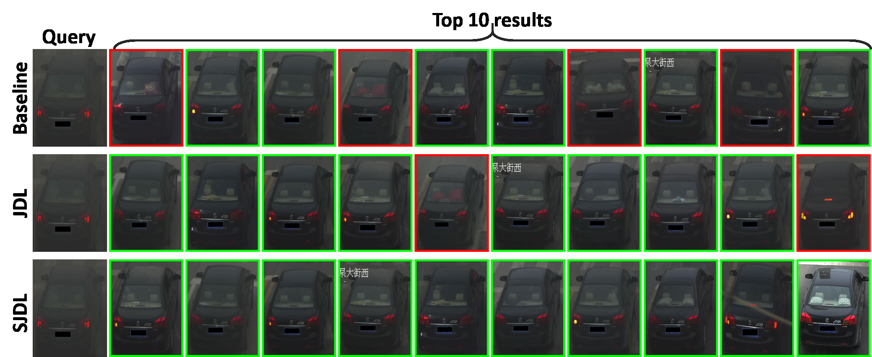
Evaluation - Effectiveness of joint defogging learning and
semi-supervised defogging optimization.
Figure 5: Visualization of the ranking list on FVRID_Real dataset.
Notes:
There present the visualization of the ranking list on FVRID_Real dataset in Fig. 5.
One can see that, the baseline may retrieve the wrong instance because the crucial features such as light and window may become ambiguous, which may degrade the feature extraction of the
network.
However, with the proposed JDL, clear features can be extracted and the performance vehicle ReID in the foggy weather can be improved.
Furthermore, n Table 4 and Fig. 5 show that One can see that the proposed
semi-supervised optimization can generate more desirable defogged results in real-world scenarios, which may further benefit the performance of vehicle ReID.

Slide 10
05
Contribution of the paper
A novel training framework that unifies the defogging network and re-identification network is proposed.
A semi-supervised defogging training mechanism is proposed.
Construct a dataset called Foggy Vehicle ReID (FVRID).
Notes:
In this paper, to alleviate the vehicle ReID problem in the foggy weather, the proposed a semi-supervised joint defog_x0002_ging learning (SJDL) system that can conduct defogging and
vehicle ReID simultaneously. Moreover, this framework can solve the performance gap between real-world and synthetic scenarios, Furthermore, to train the proposed network, we
construct a dataset called FVRID which contains synthetic and real-world foggy images. Experimental results indicate the proposed method can achieve superior performance than
existing methods and each of the proposed modules contributes to the performance of the network.

Slide 11
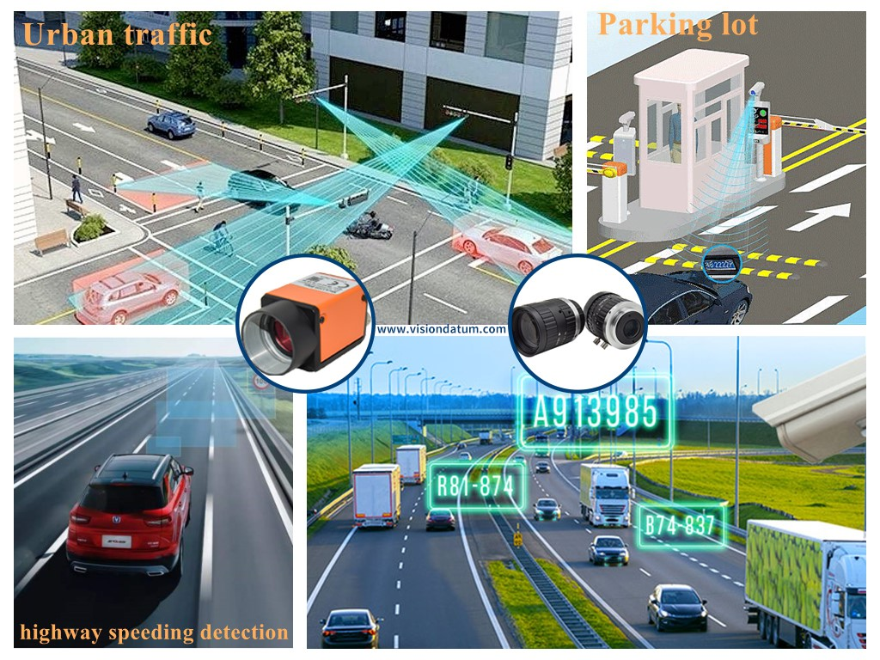
05
Contribution of the paper- practical implications
Whether the proposed solution will work in real-world systems?
Yes.
Its goal is to find images of the same vehicle in a large gallery set based on a query image under multiple cameras and various viewpoints.
Who would want it?
Intelligent transportation and publisecurity systems.
Vehicle ReID is indispensable for building intelligent transportation and publisecurity systems.
Notes:
Vehicle ReID is indispensable for building intelligent transportation and publisecurity systems. Its goal is to find images of the same vehicle in a large gallery set based on a query image under multiple cameras and various viewpoints.
For work that has practical implications, it is important to consider whether the proposed solution will work in real-world systems, who would want it, what it will take to give it to them, and when it might become a reality.
The proposed SJDL system has practical implications for building intelligent transportation and public security systems, Its goal is to find images of the same vehicle in a large gallery set based on a query image under multiple cameras and various viewpoints.
Addiitionally, it may be of interest to researchers and practitioners in these fields.

Slide 12
06
Our Questions
Does this model can performed well on other dataset in the real world senario?
It seemed biased towards their model, because they seemed to use the data the model was trained on to evaluate theirs and all the rest, which may have been why their model performed well.
Does the Synthetic Dataset construction reasonable?
They select fog-free images from VERI Wild and Vehicle-1M datasets, Then, they synthesize these images based on the fog synthesis process in. We think, the same fixed algorithm is used to add fog to all the clear image, and the effect is quite different from the real world senario
We didn't understand what the cumulative matching characteristics were based on when evaluating the model.
Notes:
. It seemed biased towards their model because they seemed to use the data the model was trained on to evaluate theirs and all the rest, which may have been why their model performed well.
This paper construct a synthetic training set called FVRID_Syn for the training process. They select fog-free images from VERI Wild and Vehicle-1M datasets, Then, they synthesize these images based on the fog synthesis process in. We think, the same fixed algorithm is used to add fog to all the clear image, and the effect is quite different from the real world senario. Because in the real world, the fog indifferent image is very variation. This maybe the reason why their model performance very on their dataset.
I also didn't understand what the cumulative matching characteristics were based on when evaluating the model.

Slide 13
THANK YOU FOR LISTENING !

